Slide 1
Quicklook observations
Highlighted runs

Slide 2
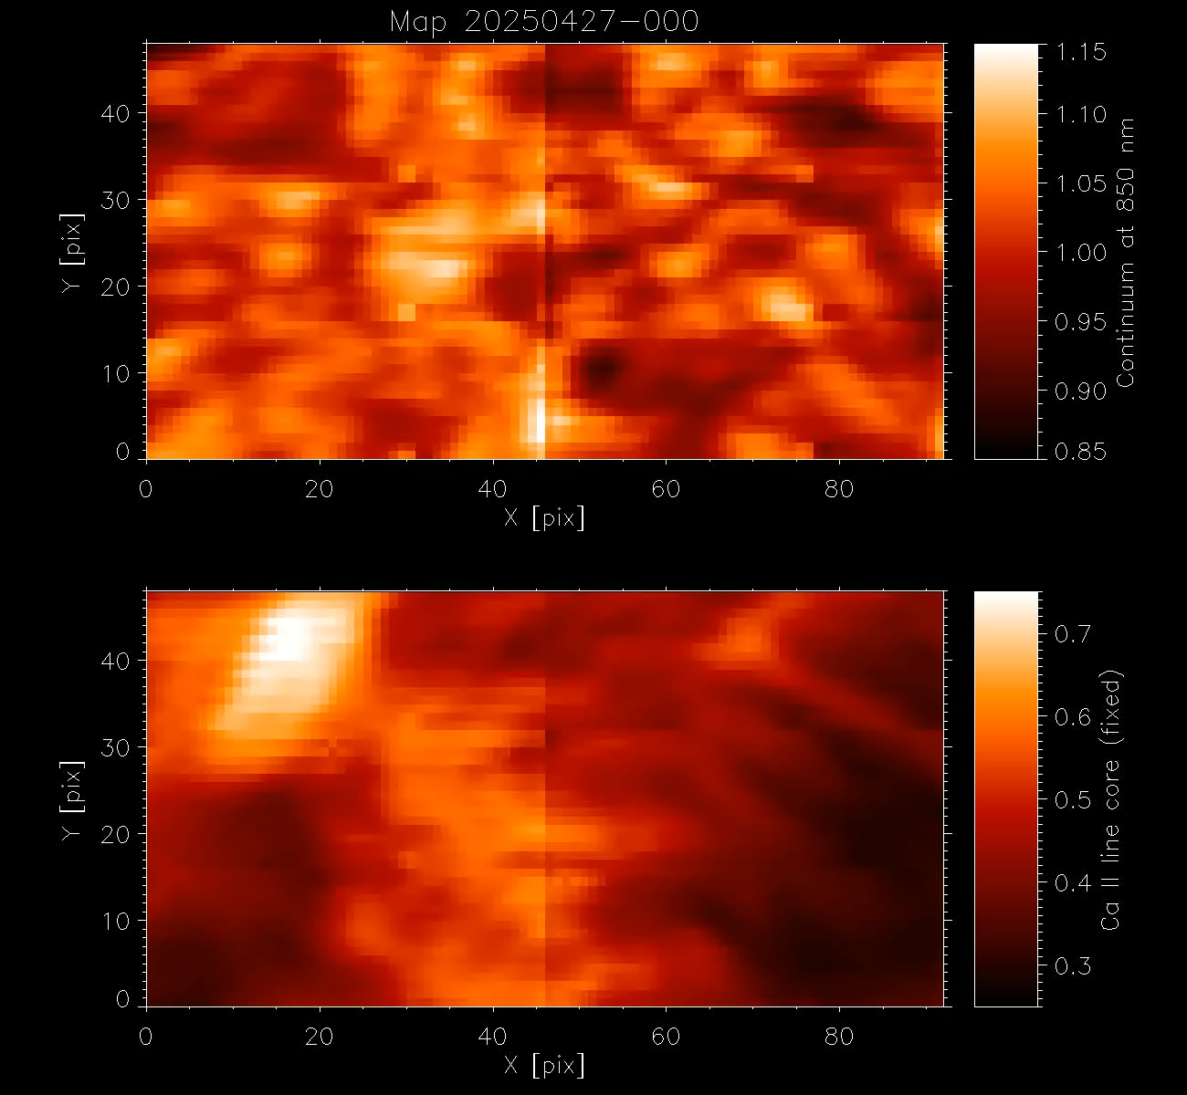
Slit-jaw images
Carlos
SCAN. AR14072. Solar coordinates; X=-296, Y=-258.
acc=10, steps_v=3, steps_h=2, t_int=70ms, operations=50

Slide 3
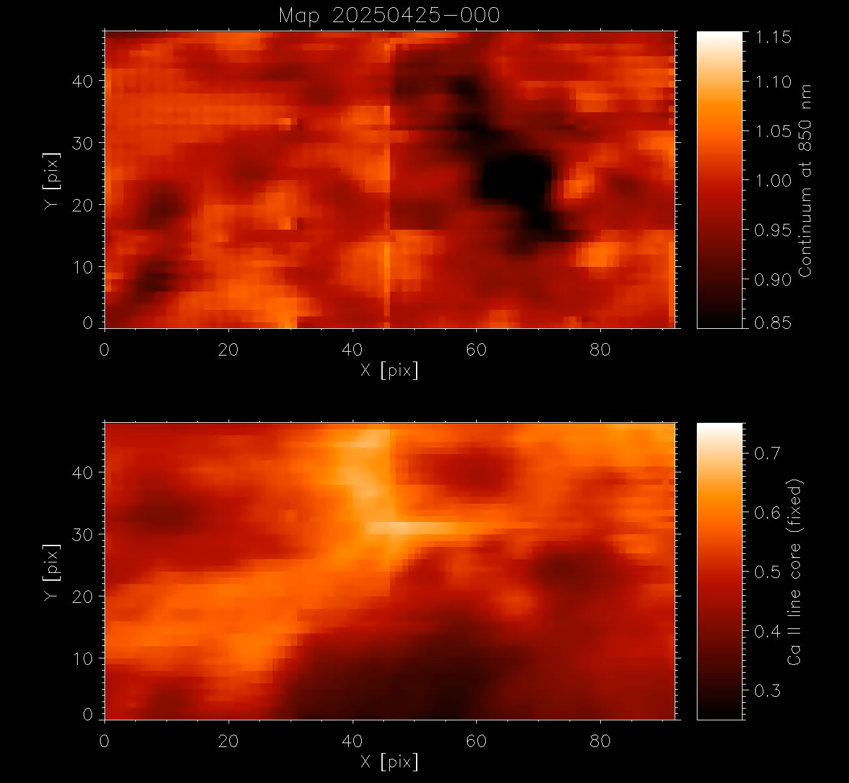
Slit-jaw images
SCAN. AR14069. Solar coordinates; X=+368, Y=-46. Pore in between sunspot acc=10, steps_v=3, steps_h=2, t_int=70ms, operations=50

Slide 4
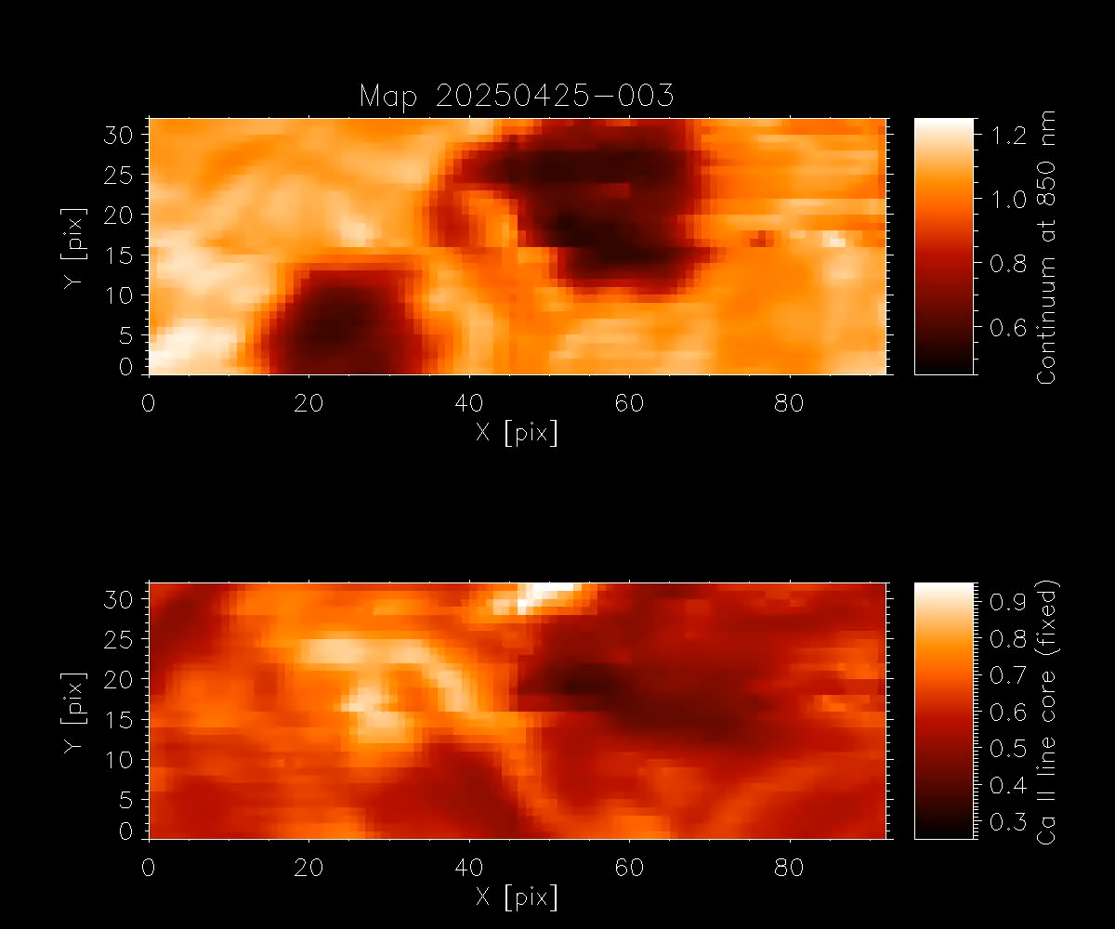
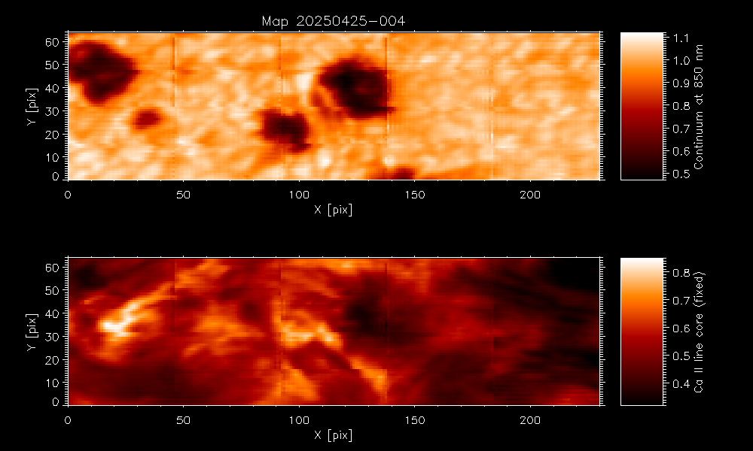
SCAN. AR14073. Solar coordinates; X=-577, Y=288. Context map
acc=10, steps_v=4, steps_h=5, t_int=70ms, operations=1
Harsh
SCAN. AR14073. Solar coordinates; X=-577, Y=288.
acc=10, steps_v=2, steps_h=2, t_int=70ms, operations=30

Slide 5
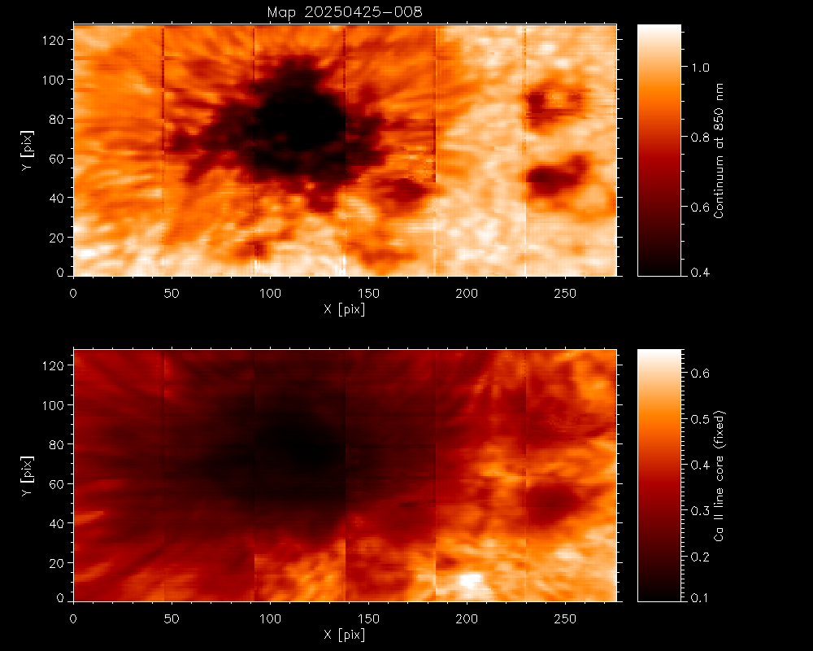
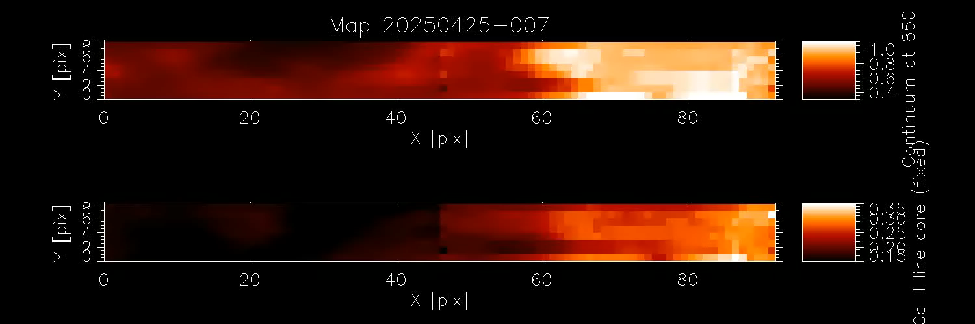
SCAN. AR14070. Solar coordinates; X=-577, Y=288. Context map
acc=10, steps_v=8, steps_h=6, t_int=70ms, operations=1
SCAN. AR14070. Solar coordinates; X=-577, Y=288. Umbra flashes
acc=10, steps_v=1, steps_h=2, t_int=70ms, operations=100

Slide 6
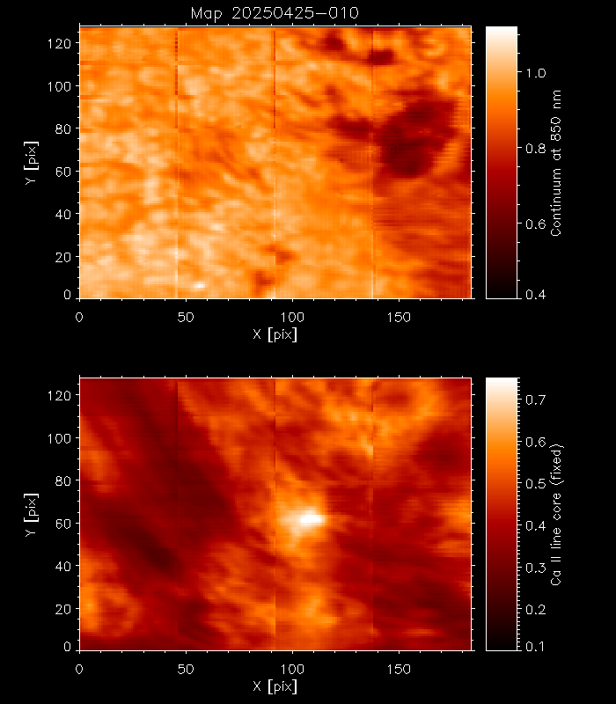
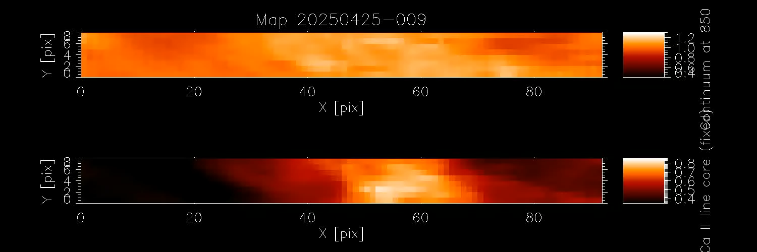
SCAN. AR14064. Solar coordinates; X=577, Y=285. Context map
acc=10, steps_v=8, steps_h=4, t_int=70ms, operations=1
SCAN. AR14064. Solar coordinates; X=577, Y=285. Ca II emission
acc=10, steps_v=1, steps_h=2, t_int=70ms, operations=100

Slide 7
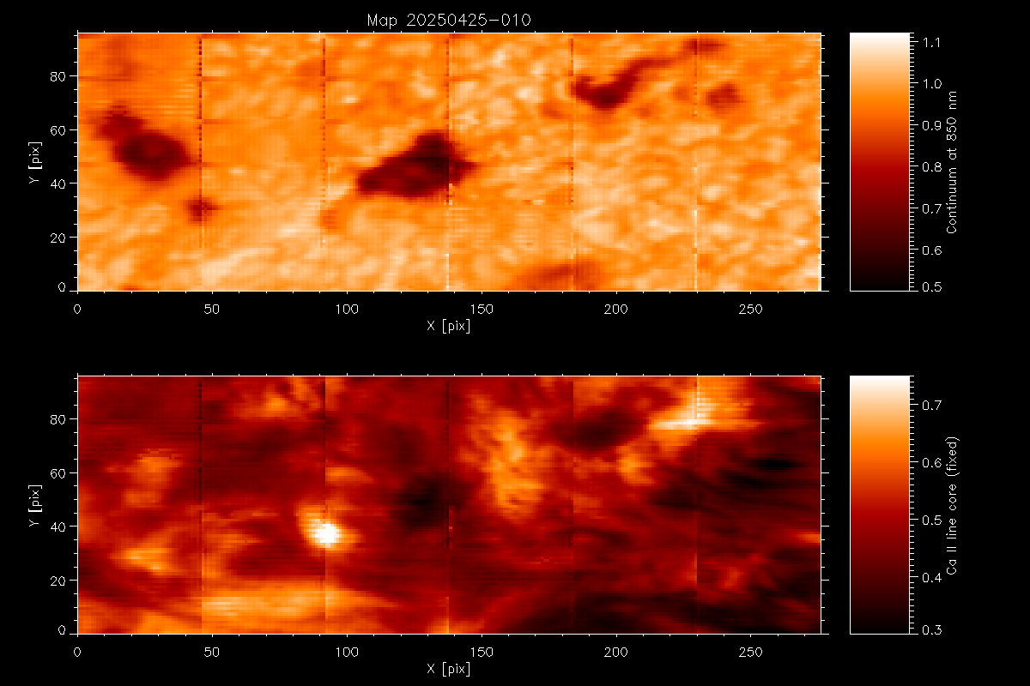
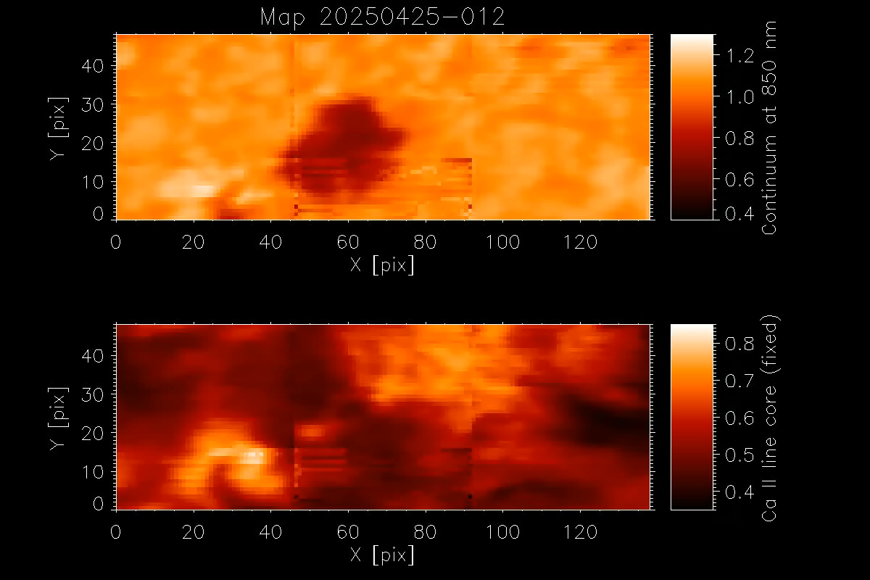
SCAN. AR14073. Solar coordinates; X=-517, Y=317. Context map
acc=10, steps_v=6, steps_h=6, t_int=70ms, operations=1
SCAN. AR14073. Solar coordinates; X=-517, Y=317 Ca II emission
acc=10, steps_v=3, steps_h=3, t_int=70ms, operations=30
Fabiana

Slide 8
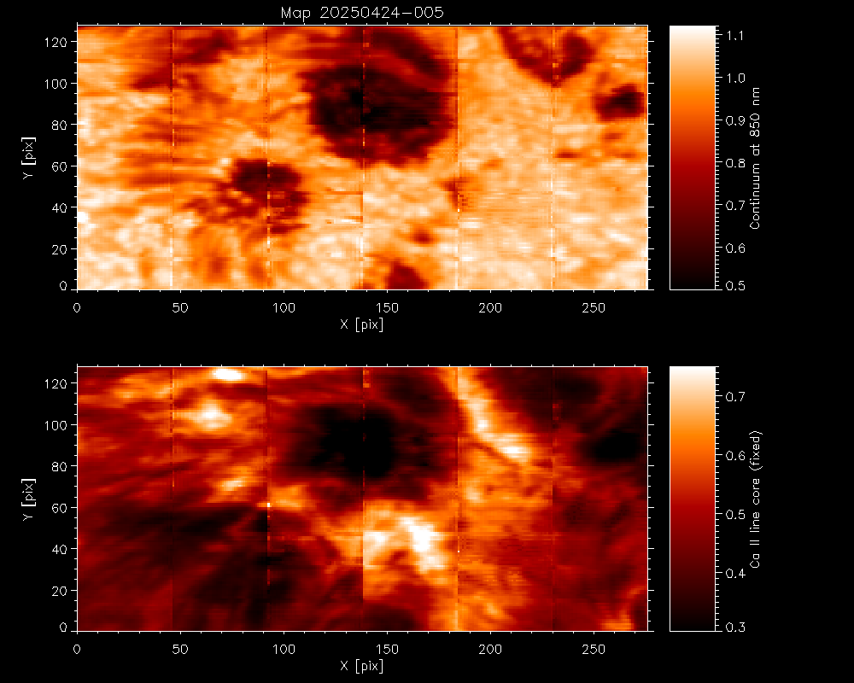
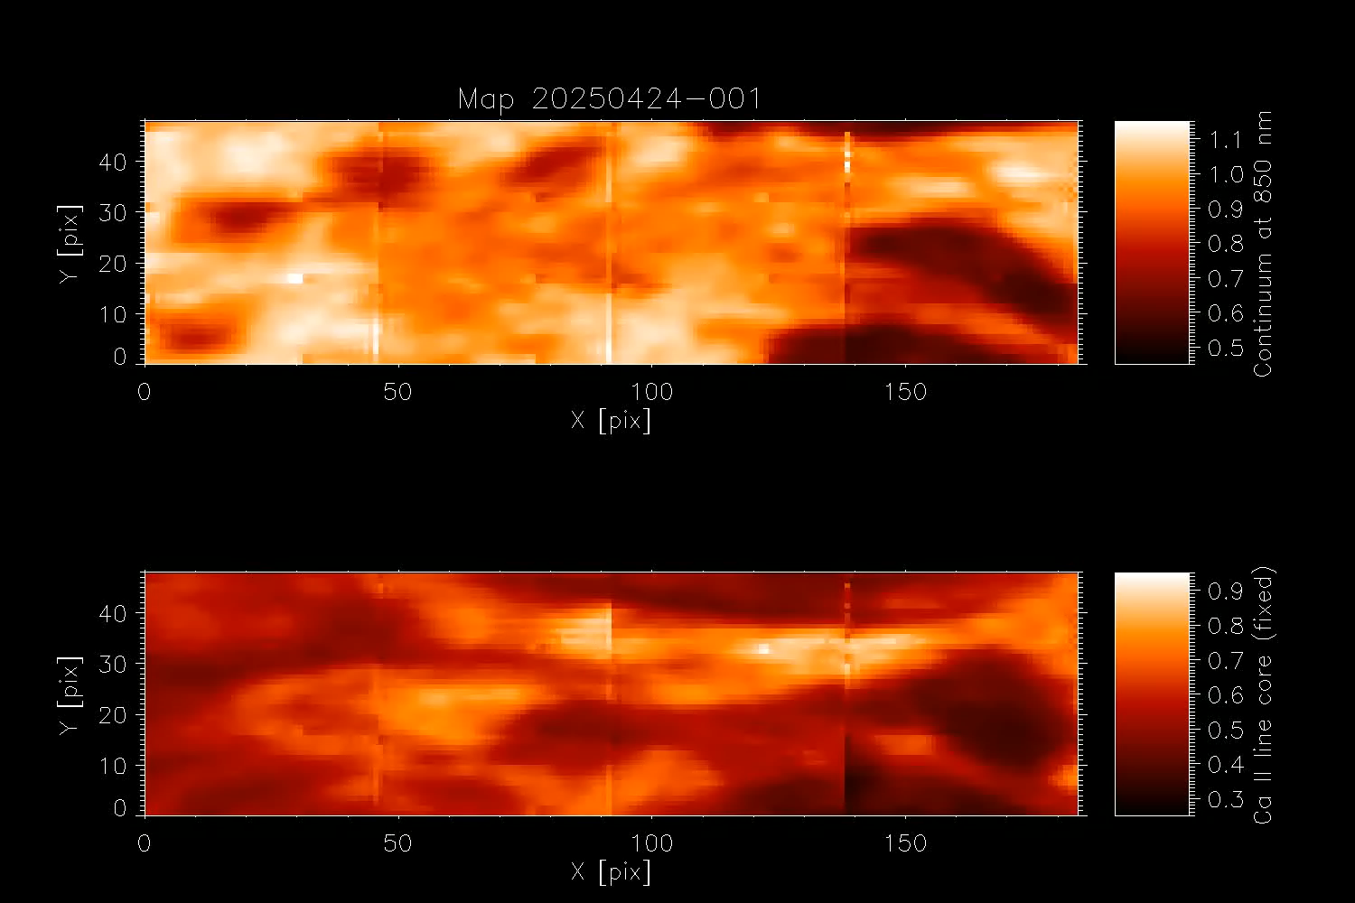
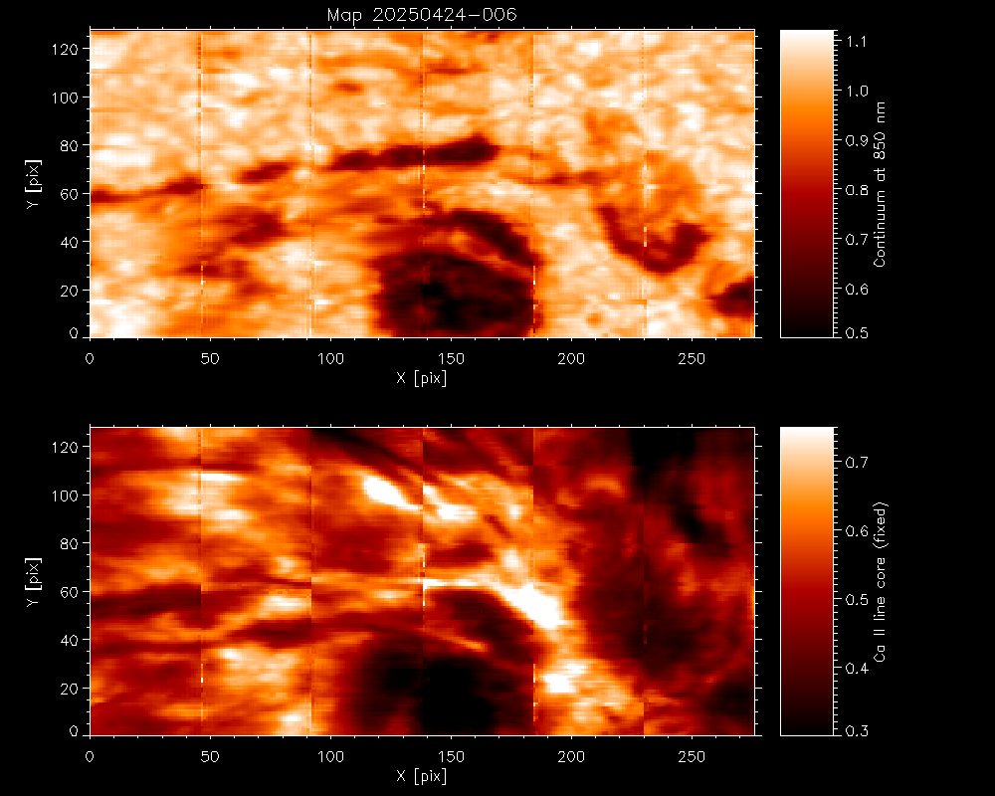
Context map 005
Annu
SCAN. AR14070. Solar coordinates; X=-345, Y=-163. opposite polarity LB
acc=10, steps_v=3, steps_h=4, t_int=70ms, operations=25 (aborted at 20)
Context map 006

Slide 9
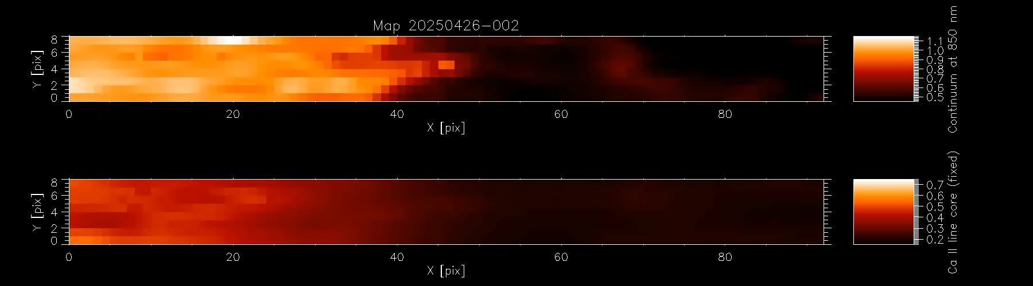
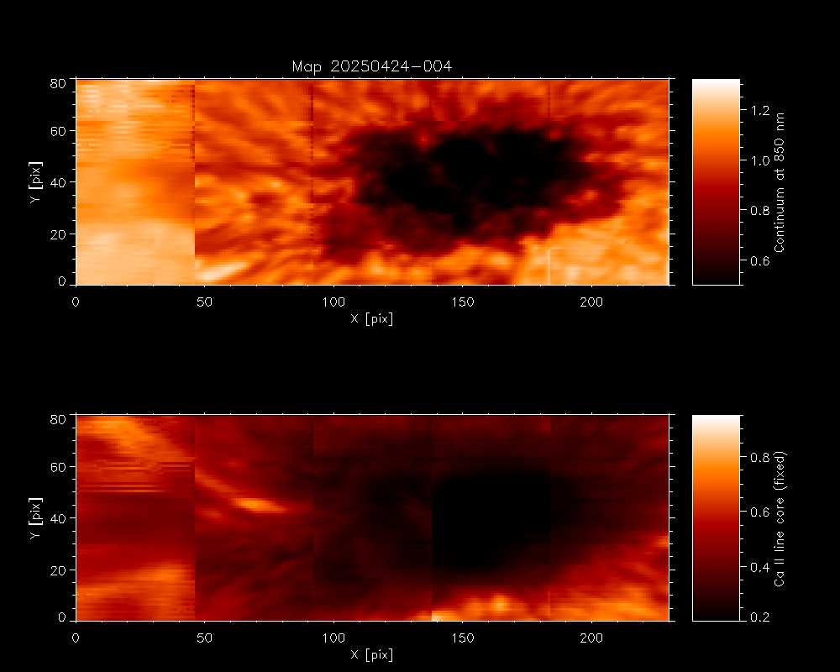
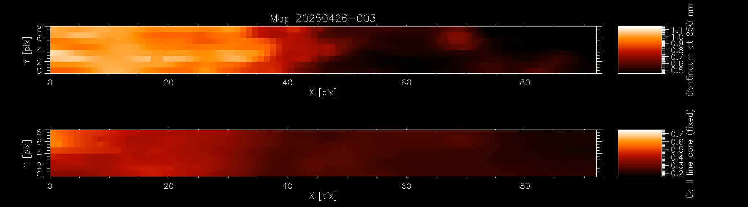
SCAN. AR14070. Solar coordinates; X=+32, Y=-111. Umbra-penumbra boundary, umbral flashes
acc=10, acc=10, steps_v=1, steps_h=2, t_int=70ms, operations=100
Jayant
Context map 004
SCAN. AR14070. Solar coordinates; X=+32, Y=-111. Umbra-penumbra boundary, umbral flashes
acc=10, steps_v=1, steps_h=2, t_int=70ms, operations=100

